Slide 1

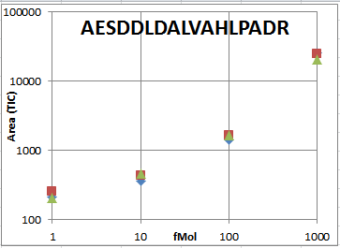
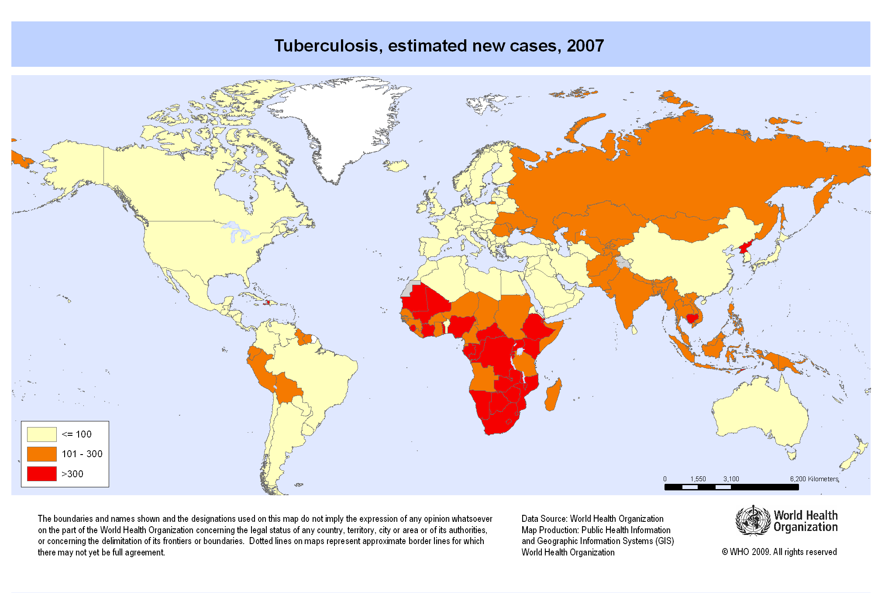
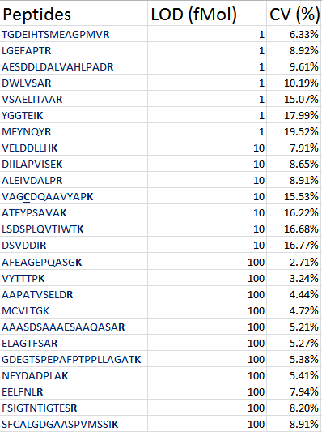
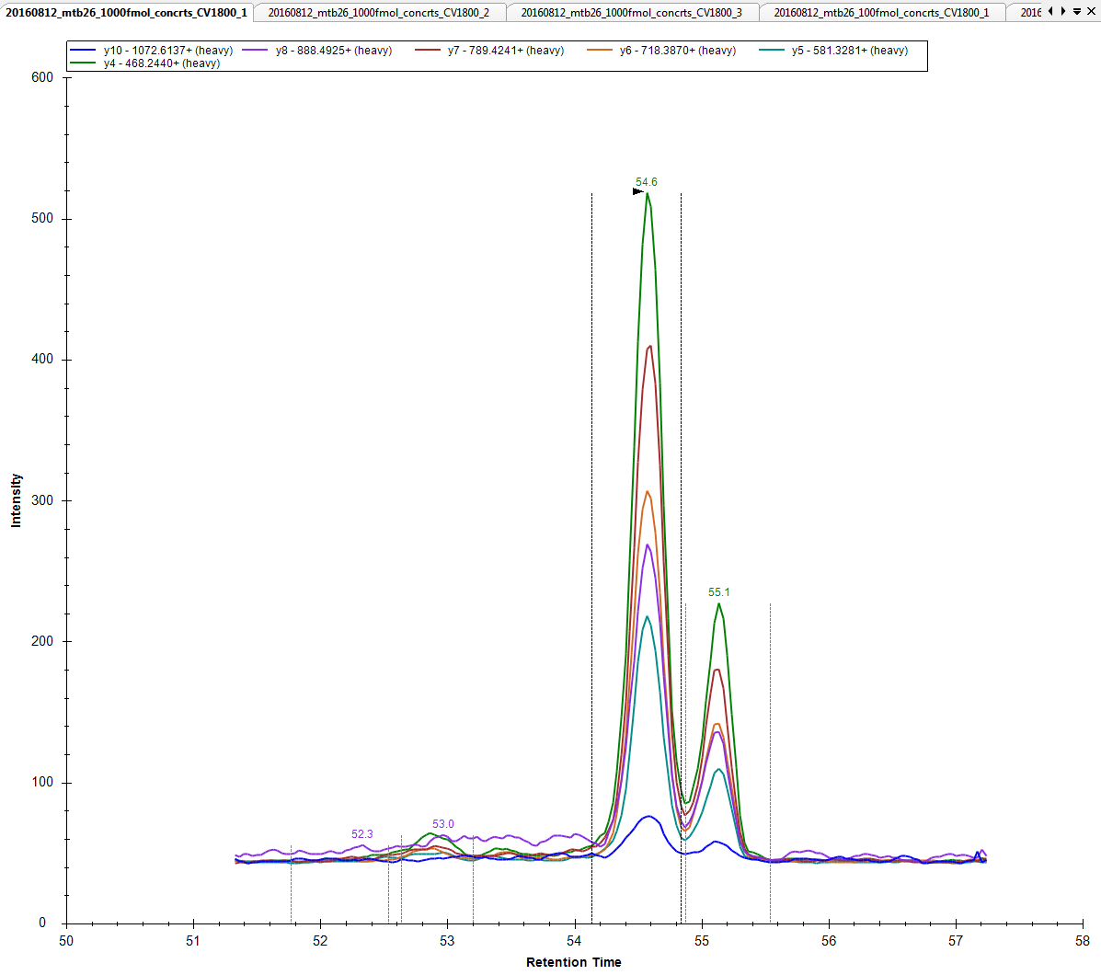
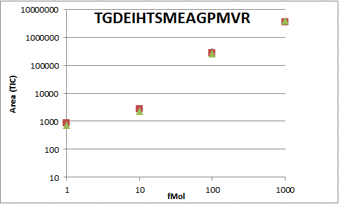
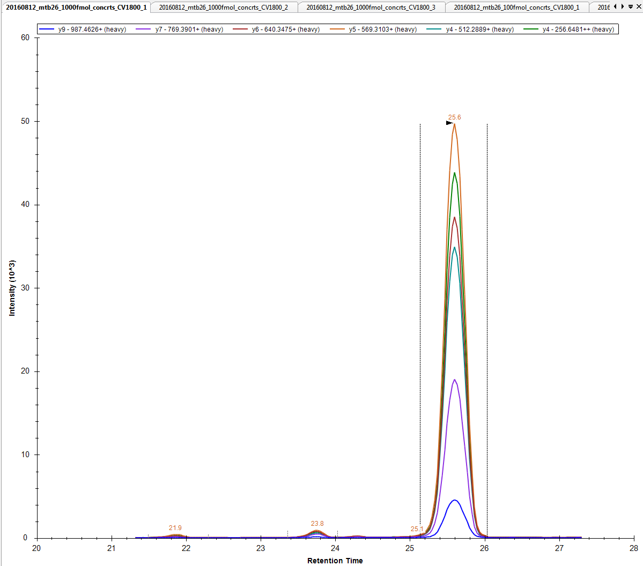
Developing a SRM Assay of Tuberculosis for Clinical Sample Diagnosis
￼
Contributors
Gower.M, Moss.C, Li.S, Chen.G, Kahlert.G, Kusebauch.U, Grimes.B, Arens.N, Ludwig.C, Moritz.R
Abstract
MTB is still a threat to those in poorer countries, killing 1.5 million a year. With given data of secreted proteins specific to tuberculosis clinical samples, we created an SRM assay to attribute to the creation of a biomarker for tuberculosis infection.
METHODS
Cleanup
Obtain clinical samples from active TB patients
Denature the proteins within with 8M Urea
Cleave disulfide bonds with 5mM Dithiothreitol (DTT)
Cap the cysteine peptidases with 14mM of Iodoacetamide, incubate in dark room 30min
Add Trypsin (1:100 ratio to protein by mass) to the sample and incubate in 30C overnight. This cleaves the proteins at Lysines and Argenines and allows for a minimum of a +2 charge on the peptides
Clean samples in C18 columns, purifying peptides from other organic material
Measure the concentration of the protein using a BCA assay.
Dry samples in speed vac and re-suspend protein in loading buffer (2% ACN and 0.1% FA) at final concentration of 1mg/mL
Scheduled SRM
Select optimal transition list using MTB data base on the SRM Atlas (ISB)
I made an equimolar solution of all 26 peptides at a concentration of 1,000 fMol
Spike an equimolar solution of each targeted heavy labeled peptides into BSA background prepared analogously to sample
After verifying the sensitivity of the machine with a 15 min HSA run, Inject the 1,000fMol sample of the peptides through unscheduled SRM at 90 minutes and record retention times. I ran mine with an Agilent 6460 QQQ.
Adjust retentions times into a scheduled LC/MS SRM method. Also adjust the delta retention time to 3 minutes.
Create a dilution series of each peptide at 1,000, 100 , 10, and 1 fMol and run through the mass spectrometer in triplicate.
Create a calibration curve of each of the 26 peptides at all of the concentrations, form this one can isolate peptides that have the lowest quantification threshold
Data Analysis
Import data collected into Skyline
Verify correct peak selection and integration windows
Export peak area for each replicate
Calculate the coefficient of variance of each concentration of each peptide
Build a calibration curve to validate linear response.
Peptides With Optimal LOD
Results
In this project we developed an SRM assay for 26 diagnostic Biomarkers in clinical samples.
All 26 peptides were successfully detected in a simulated clinical sample background (BSA) the best performing peptides had a limit of detection within the fMol range but the maximum lowest performing peptides had a limit of detection in at least 100 fMol. Calibration curves all validated a linear response to sample concentration.
This assay is now ready to be deployed as a high through-put screening method of patient samples.
Ranked Peptides in relation to LOD
Calibration curve and representative SRM chromatogram for
AESDDLDALVAHLPADR (Rv0036c)
Background
Most commonly a pulmonary infection, Tuberculosis is a highly contagious airborne bacteria, requiring only 1-3 living bacteria to survive in the body. TB reproduces at a rate roughly 16 times slower than the average bacterial infection and as a result, requires at least a 13 day incubation period, allowing those who show no signs of infection to spread bacteria. Those infected can spray large quantities of tiny droplets, sizing 0.5 ml-5 µml, carrying the infection by talking, coughing and sneezing. Patients eventually develop fever, a productive cough, fatigue, rapid weight loss, night sweats, and nodules in the lungs (bullae). These bullae are directly caused by the attack of the macrophage in the presence of tuberculosis. When the macrophage envelops the bacteria, TB resists destruction by emitting a protein which inhibits the macrophage lysosomes from fusing and creating hostile enzymes. The bacteria multiplies over a span of a few weeks and takes over the cell. During this time, the macrophage presents antigens unique to TB on its outer layer to call for the help of a T-cell activated macrophage. If a macrophage attempts to assist the host cell, tuberculosis will move on to infect the activated macrophage, leaving its original hosts dead. This cycle continues until a mass of dead tissue is left in tuberculosis’s wake, creating the masses of dead cells found inside the lungs. The bullae also effectively shields TB from any more of the body’s natural immune response.
Because the bullae shield the infection from the rest of the body, those who are infected may never show signs of tuberculosis, yet still harbor it. This latent infection can be activated into full-blown TB in those who have been exposed to the bacteria months or even years after initial exposure if at any point there is a weakness in their immune system. For this reason, latent TB can particularly affect those with immunodeficiency diseases, increasing their rate of active infection by 10% each year after exposure.
.
CONCLUSIONS
Based on the limits of detection found between the results of each peptide in triplicate, we have identified an assay for diagnostic screening that could be investigated more as potential biomarkers for clinical samples of tuberculosis patients. Specifically, AESDDLDALVAHLPADR, LGEFAPTR, and TGDEIHTSMEAGPMVR have consistently lower coefficients of variance and could be tested as targets for antibodies in the diagnosis of tuberculosis.
References
Hesseling, et al. Disseminated Bacille Calmette–Guérin disease in HIV-infected South African infants. Bulletin of the World Health Organization (2008)
Kusebauch, et al. Human SRMAtlas: A resource of targeted assays to quantify the complete human proteome
Cell 2016, 166(3), 766-778
Schubert, et al. The Mtb Proteome Library: A Resource of Assays to Quantify the Complete Proteome of Mycobacterium tuberculosis
Cell Host & Microbe 2013, 13(5), 602-612
Calibration curve and representative SRM chromatogram for
TGDEIHTSMEAGPMVR (Rv1837c)

